Slide 1
Introduction to Programming
Modular Programming with Functions

Slide 2
Function
Execution of a program begins with the statements in the main function.
Managing a project’s code becomes challenging as your project grows
The main function can call other functions
A function is a set of statements / codes that performs a task or computes a value.
A function can also be called from any other functions / even from within itself

Slide 3
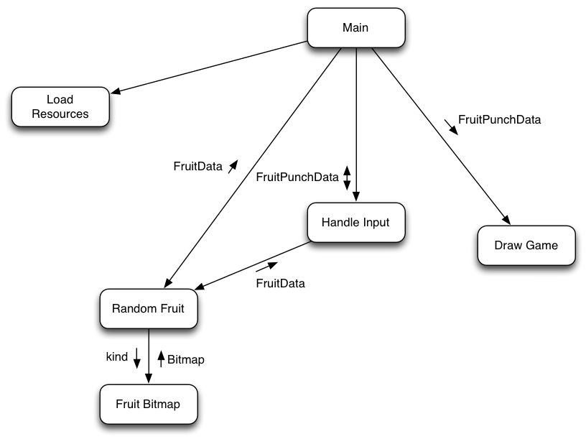
Examples of Structure Charts
Structure charts show how calls are structured
Each function may call other functions.

Slide 4
Examples of Structure Charts
Use small arrows to indicate data flow
Parameters flowing into a function/procedure, function results and variable parameters flowing

Slide 5
Advantages of using function
Function can be written and tested separately.
Promotes code re-use. - a module written and tested once can be re-used (called) many times.
Reduces length of program, making it more readable.
Promotes the concept of abstraction.
Large projects can be developed in parallel by several team members.

Slide 6
Functions
Pre-defined
  standard libraries e.g. printf().. scanf().
  third party libraries e.g. koolplot.
Programmer defined
  written by anyone (could be you or me).

Slide 7
Pre-defined Functions
Example:
#include <stdio.h>
#include <math.h>
int main(void)
{
double angle;
printf( “input angle in radians: \n“);
scanf( “%1f”, &angle);
printf( “\nThe sine of the angle is %f\n“, sin(angle) );
return 0;
}
Spot the function
calls!

Slide 8
Programmer Defined Functions

Slide 9
Functions
The execution of a program always begin with the main function.
Additional functions are called or invoked when the program encounters function names.
These additional functions must be defined.

Slide 10
Example
#include <stdio.h>
void favgame ( ); /*function prototype*/
main(void)
{
printf(“South Park\n”); /* 1 */
printf(“Hearthstone“\n”); /* 2 */
favgame( ); /*call statement*/
printf(“Titanfall\n”); /* 5 */
printf(“Dark Souls 3\n”); /* 6 */
}
void favgame( ) /*function definition*/
{
printf(“Two Dots\n”); /* 3 */
printf(“Dark Souls 2\n”); /* 4 */
}
Output on screen:
South Park
Hearthstone
Two Dots
Dark Souls 2
Titanfall
Dark Souls 3
#include <stdio.h>
main(void)
{
printf(“South Park\n”); /* 1 */
printf(“Hearthstone“\n”); /* 2 */
printf(“Two Dots\n”); /* 3 */
printf(“Dark Souls 2\n”); /* 4 */
printf(“Titanfall\n”); /* 5 */
printf(“Dark Souls 3\n”); /* 6 */
}
Output on screen:
South Park
Hearthstone
Two Dots
Dark Souls 2
Titanfall
Dark Souls 3

Slide 11
Programmer Defined Functions
Terminology:
Function Prototype
  describes how a function is called.
Function Definition
Formal Parameters
  used in function definition.
Function Call
Actual parameter
  used in the function call.
Formal parameters must match with actual parameters in order, number and data type.

Slide 12
Function prototype
Example:
  double sinc(double angle);
or double sinc(double);
Function prototypes can be located at the top of the file as in the previous example.
All function prototypes can be put in a custom header file *.h (stored in the working directory). The file is then referenced with an include statement, e.g.
#include "myheader.h"
Preferable alternative (clearer)

Slide 13
Storage Class and Scope
Scope refers to the portion of the program in which it is valid to reference a function or a variable.
The scope of an identifier is the area where it can be accessed.
Storage class refers to the lifetime of a variable.

Slide 14
Scope
Local scope - a local variable is defined within a function or a block ({...}) and can be accessed only within the function or block that defines it.
Global scope - a global variable is defined outside the main function and can be accessed by any function within the program file.

Slide 15
Scope Example
#include <stdio.h>
int count = 0;
…
int main(void)
{
int x, y, z;
…
}
int calc(int a, int b)
{
int x;
…
}
int check(int sum)
{
int w;
…
}
Variable count is a global variable that can be referenced by all functions.
a, b and x are local variables that can only be accessed in function calc.
There are two local variables x, these are two different variables with different scopes.

Slide 16
Example
#include <stdio.h>
void favgame ( ); /*function prototype*/
main(void)
{
printf(“South Park\n”); /* 1 */
printf(“Hearthstone“\n”); /* 2 */
favgame( ); /*call statement*/
printf(“Titanfall\n”); /* 5 */
printf(“Dark Souls 3\n”); /* 6 */
}
void favgame( ) /*function definition*/
{
printf(“Two Dots\n”); /* 3 */
printf(“Dark Souls 2\n”); /* 4 */
}
Output on screen:
South Park
Hearthstone
Two Dots
Dark Souls 2
Titanfall
Dark Souls 3
#include <stdio.h>
main(void)
{
printf(“South Park\n”); /* 1 */
printf(“Hearthstone“\n”); /* 2 */
printf(“Two Dots\n”); /* 3 */
printf(“Dark Souls 2\n”); /* 4 */
printf(“Titanfall\n”); /* 5 */
printf(“Dark Souls 3\n”); /* 6 */
}
Output on screen:
South Park
Hearthstone
Two Dots
Dark Souls 2
Titanfall
Dark Souls 3

Slide 17
A Programmer Defined Function
#include <stdio.h>
main(void)
{
int x = 2; /* 1 */
printf(“South Park\n”); /* 2 */
printf(“Hearthstone“\n”); /* 3 */
printf(“Two Dots\n”); /* 4 */
printf(“Dark Souls %i\n”, x); /* 5 */
x++; /* 6 */
printf(“Titanfall\n”); /* 7 */
printf(“Dark Souls %i\n”, x); /* 8 */
}
#include <stdio.h>
int favgame (int a); /*function prototype*/
main(void)
{
int x = 2; /* 1 */
printf(“South Park\n”); /* 2 */
printf(“Hearthstone“\n”); /* 3 */
x = favgame(x); /*call statement*/
printf(“Titanfall\n”); /* 7 */
printf(“Dark Souls %i\n”, x); /* 8 */
}
int favgame(int a) /*function definition*/
{
printf(“Two Dots\n”); /* 4 */
printf(“Dark Souls %i\n”, a); /* 5 */
a++; /* 6 */
return a;
}
Function definition - formal parameters

Slide 18
A Programmer Defined Function
#include <stdio.h>
main(void)
{
int x = 2; /* 1 */
printf(“South Park\n”); /* 2 */
printf(“Hearthstone“\n”); /* 3 */
favgame( ); /*call statement*/
printf(“Titanfall\n”); /* 7 */
printf(“Dark Souls %i\n”, x); /* 8 */
}
void favgame( ) /*function definition*/
{
printf(“Two Dots\n”); /* 4 */
printf(“Dark Souls %i\n”, x); /* 5 */
x++; /* 6 */
}
#include <stdio.h>
int favgame (int a); /*function prototype*/
main(void)
{
int x = 2; /* 1 */
printf(“South Park\n”); /* 2 */
printf(“Hearthstone“\n”); /* 3 */
x = favgame(x); /*call statement*/
printf(“Titanfall\n”); /* 7 */
printf(“Dark Souls %i\n”, x); /* 8 */
}
int favgame(int a) /*function definition*/
{
printf(“Two Dots\n”); /* 4 */
printf(“Dark Souls %i\n”, a); /* 5 */
a++; /* 6 */
return a;
}
Function definition - formal parameters
Syntax error, variable x is undeclared

Slide 19
Storage Class - 4 types
automatic - key word auto - default for local variables
  Memory set aside for local variables is not reserved when the block in which the local variable was defined is exited.
external - key word extern - used for global variables
  Memory is reserved for a global variable throughout the execution life of the program.
static - key word static
  Requests that memory for a local variable be reserved throughout the execution life of the program. The static storage class does not affect the scope of the variable.
register - key word register
  Requests that a variable should be placed in a high speed memory register.

Slide 20
Passing Array as Parameters
Refer lecture note lecture 5 (slides 16)
Example
  int main(void)
  {
  int xarr[2][5] = {{1, 2, 3, 4, 5}, {5, 4, 3, 2, 1}};
  display(xarr);
  }
  void display(int yarr[5])
  {
  int x, y;
  for (x=0; x<5; x++)
  {
  for(y=0; y<5; y++)
  printf(“%i “, yarr[x];
  printf(“\n”);
  }
  }
Etter/Ingber PSH/JKL

Slide 21
Value Returning Functions
Function can returns a single value to the calling program.
Function definition declares the type of value to be returned.
A return expression; statement is required in the function definition.

Slide 22
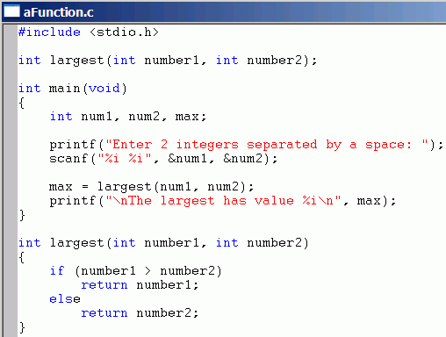
A Programmer Defined Function
prototype
Function call - actual parameters
Function definition - formal parameters

Slide 23
A Programmer Defined Function
#include <stdio.h>
main(void)
{
int num1, num2, max;
printf(“Enter 2 integers:”);
scanf(“%i %i”, &num1, &num2);
if (num1 > num2)
max = num1;
else
max = num2;
printf(“\nThe largest has value %i”, max);
printf(“Bye\n”);
}
#include <stdio.h>
int largest(int x1, int x2);
void Display();
main(void)
{
int num1, num2, max;
printf(“Enter 2 integers:”);
scanf(“%i %i”, &num1, &num2);
max = largest(num1, num2);
printf(“\nThe largest has value %i”, max);
Display();
}
int largest(int x1, int x2)
{ int larger;
if (x1 > x2)
larger = x1;
else
larger = x2;
return larger;
}
void Display()
{
printf(“Bye\n”);
}

Slide 24
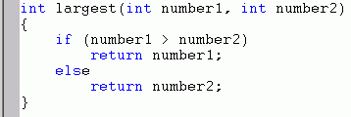
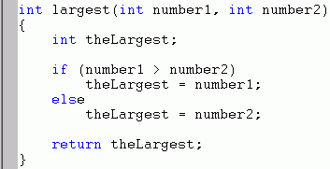
A Value Returning Function
Declaring the return type
There can be more than one
return statement, as here, but. . .
. .it is preferable to avoid
multiple return statements, as they can be confusing.
This is done here by using a local variable theLargest.
(see later)

Slide 25

Using the Returned Value
As a value on the right
of an assignment,
or as actual parameter in another function

Slide 26
Practice!
Write a function by the name CalcuateP() that will calculate the perimeter of a rectangle.
The function is passed the length and the width of the rectangle parameters, it will then return the result (perimeter).
The function is then called in main(), write the call statement.

Slide 27
Practice!
Develop a program that allows the user to enter interval limits, a and b, and then computes and prints 21 values of sinc(x) for values of x evenly spaced between a and b.
Program chapter4_2 (Etter page 154)

Slide 28
void Functions
A void function may be called to
    perform a particular task (clear the screen).
    modify data.
    perform input and output.
A void function does not return a value to the calling program.
a return; statement can be used (without return value).
Example next slide...

Slide 29
Example of void function definition
/* Print the year if it is a leap year.
* A year is a leap year if it is divisible by 4,
* with the exception of years ending in two zeros.
* Those are leap years only if divisible by 400.
*/
void print_if_leap(int year)
{
if(year % 4 != 0)
return; /* Year is not leap */
if((year % 100 == 0) && (year % 400 != 0))
return; /* Year is not leap either */
/* It’s a leap year. Print it. */
printf(“Year %d is a leap year\n”, year);
}

Slide 30
Practice!
#include <stdio.h>
#include <time.h>
int rno(){
int x;
srand( (unsigned) time(NULL));
x = rand()%4;
return x;
}
void disp(int myb[3][4]){
int x, y;
for (x = 0; x<3; x++)
{
for (y = 0; y<4; y++)
printf("%i \t", myb[x][y]);
printf("\n");
}
}
int main ( ){
int x, y, c, mya[3][4] = {{2,8,9,5}, {5,-2,0,9}, {1,8,2,2}};
disp(mya);
x = rno();
y = rno();
c = rno();
mya [x][y] = c;
disp(mya);
return 0;
}

Slide 31
Parameter Passing
Call by value (e.g. double x)
  formal parameter receives the value of the actual parameter.
  function cannot change the value of the actual parameter.
Call by reference (e.g. double &x)
  actual parameters are arrays or pointers
  (arrays and pointers will be discussed later).
  function can change the value of the actual parameter.

Slide 32
Pass by Value
#include <stdio.h>
int largest(int x1, int x2);
main(void)
{
int num1, num2, max;
printf(“Enter 2 integers:”);
scanf(“%i %i”, &num1, &num2);
max = largest(num1, num2);
printf(“\nThe largest has value %i”, max);
}
int largest(int x1, int x2)
{
if (x1 > x2)
return x1;
else
return x2;
}

Slide 33
Pass by Reference
#include <stdio.h>
void largest(int x1, int x2, int *m);
main(void)
{
int num1, num2, max;
printf(“Enter 2 integers:”);
scanf(“%i %i”, &num1, &num2);
largest(num1, num2, &max);
printf(“\nThe largest has value %i”, max);
}
void largest(int x1, int x2, int *m)
{
if (x1 > x2)
*m =x1;
else
*m = x2;
}

Slide 34
Practice! (Pass by Value)
  Determine the output of the following program:
#include <stdio.h>
void TestVarPass(int x);
int main()
{
int x= 10;
TestVarPass(x);
printf("The value of x in main is %i \n", x);
return 0;
}
void TestVarPass(int x)
{
x = 20;
printf("The value of x in function is %i \n", x);
}

Slide 35
Practice! (Pass by Reference)
Determine the output of the following program:
#include <stdio.h>
void TestVarPass(int *x);
int main()
{
int x= 10;
TestVarPass(&x);
printf("The value of x in main() is %i \n", x);
return 0;
}
void TestVarPass(int *x)
{
*x = 20;
printf("The value of x in function is %i \n", *x);
}

Slide 36
Order of Function Definition
Functions can be defined before or after the main function.
One function must be completely defined before another function begins; function definitions cannot be nested within each other.
Textbook style: main function first, then additional functions included in the order in which they are referenced in the program.
Using the textbook style, the prototypes of the additional functions must be declared before main( ).
The textbook style is favoured in many work-places.

Slide 37
main() should be as short as possible
#include <stdlib.h>
......
int main(void)
{
// declare variables and function prototypes.
......;
// open files for input/output
fopen(...);
// pass control to the main calculation function for all calculations
allcalculations(......);
// close files
.......
return 0;
}

Slide 38
Practice!
Write a function that will receive a two dimensional array of int type, and it will return the total sum of all the integer in the whole array.

